Slide 1


Slide 2

Building a Machine Learning model

Slide 3
Combine data from various sources
Check data schema:
Usually, the source of the data has schema describing the data
Clean your Data: identify and handle errors in your data.
Handle Missing data
Handle outliers
Data Transformation: change the scale of some/all variables. Why?? We will discuss it later.
Feature Selection: select these features that are most relevant to your task.
Feature Engineering: combine features, derive new variables, dimensionality reduction, etc.
Data Preparation

Slide 4
Exploratory Data Analysis
We can’t prepare the data without first exploring the data.
Quantify missing data
Identify numerical and categorical variables
Determine unique values (cardinality) in categorical features
Check rare/ dominant categories in categorical features
Highlight outliers
Identify linear relationships
Identify a normal distribution
Check histograms

Slide 5
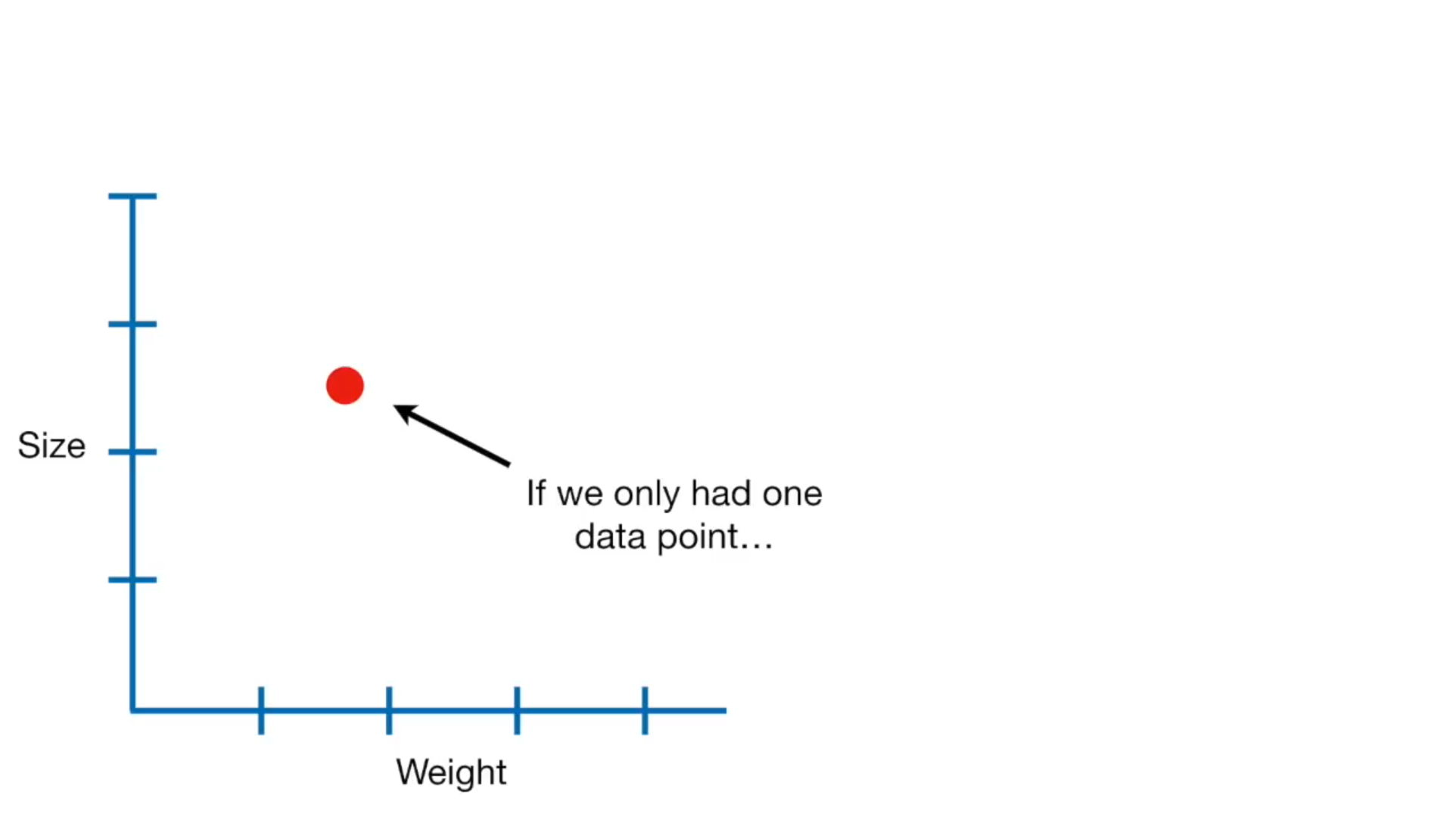

Slide 6
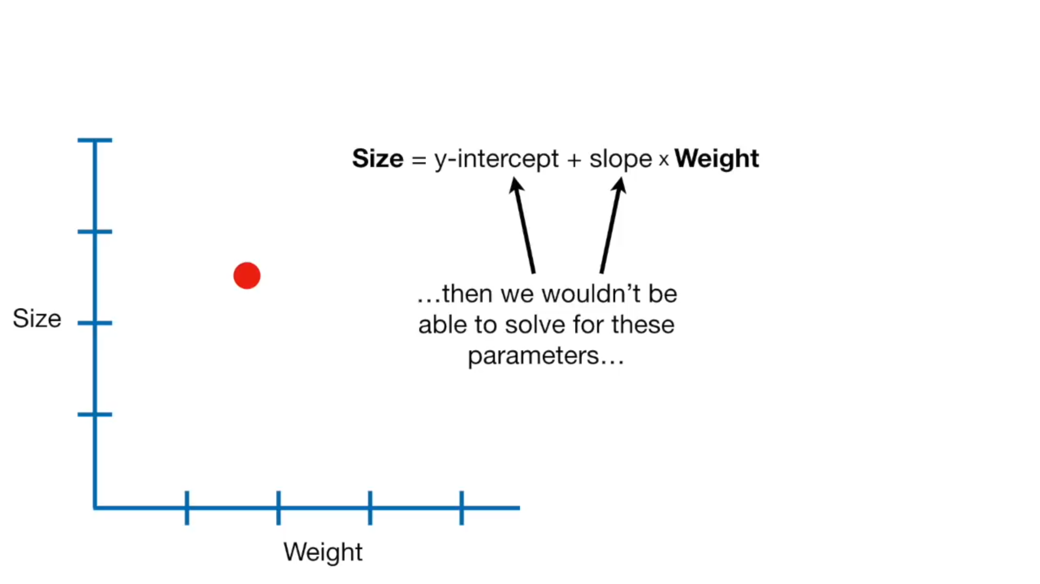

Slide 7
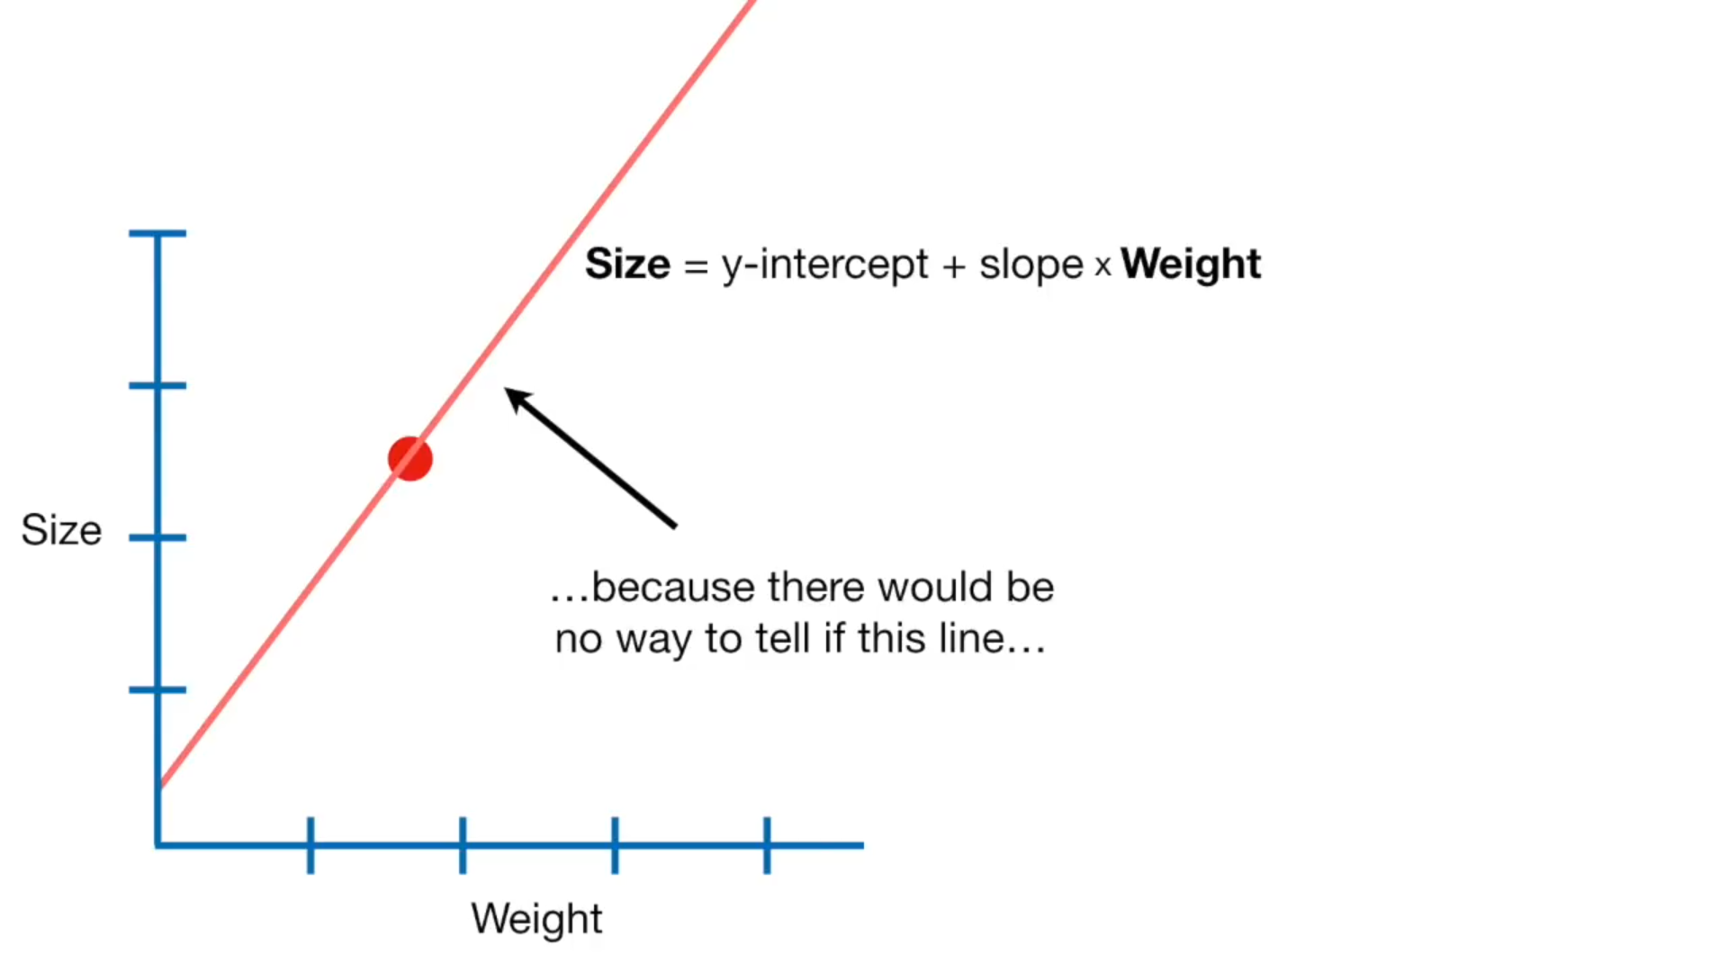

Slide 8
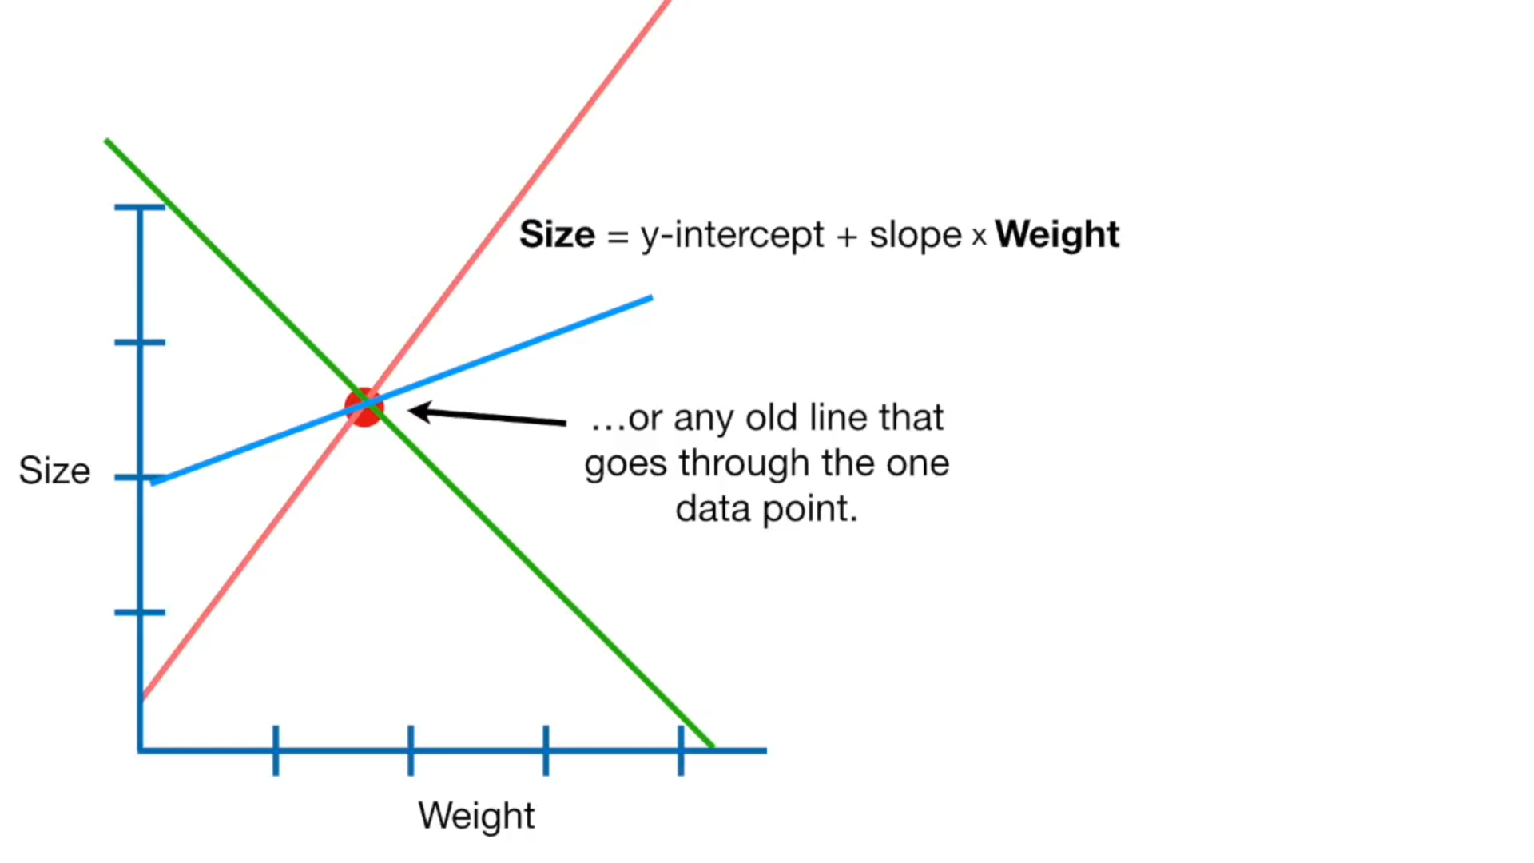

Slide 9
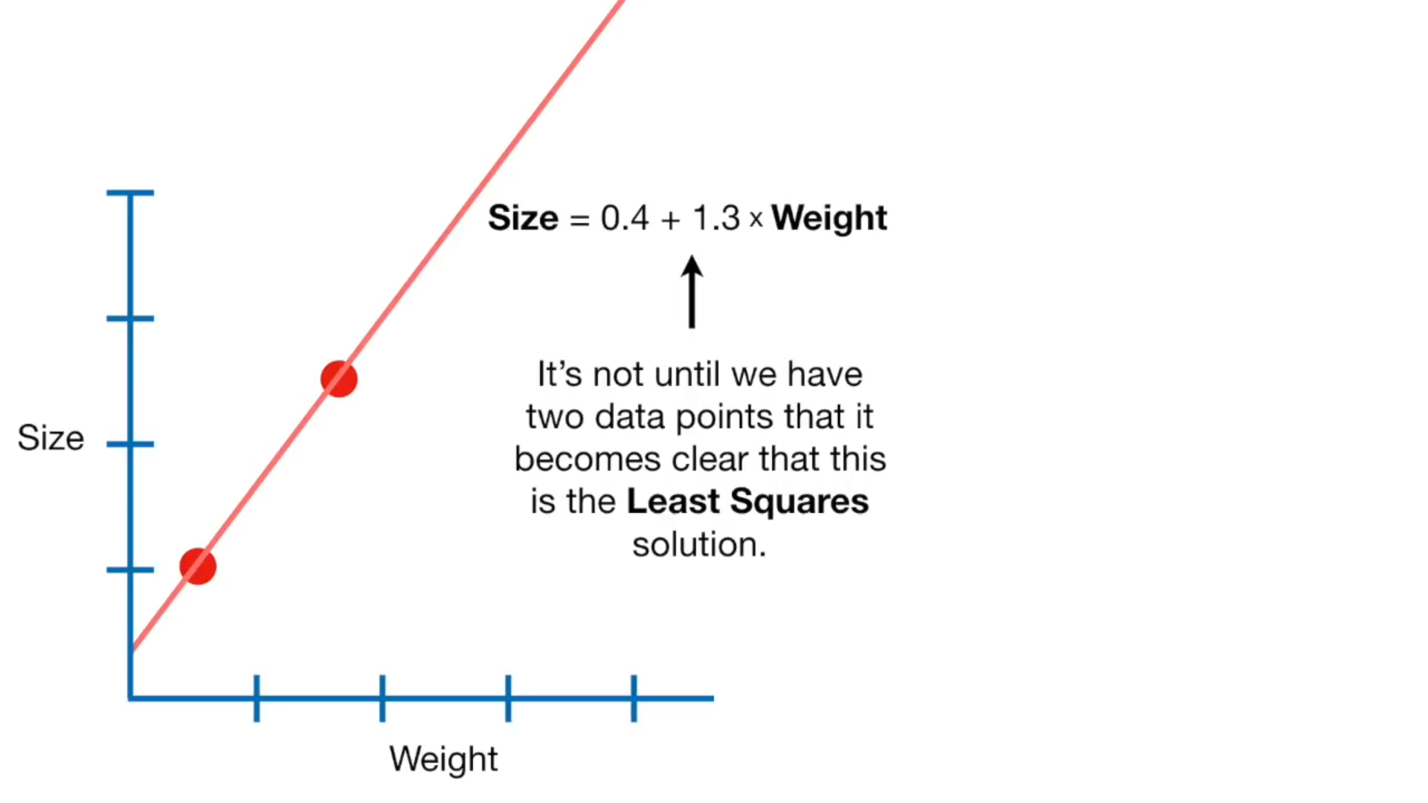

Slide 10
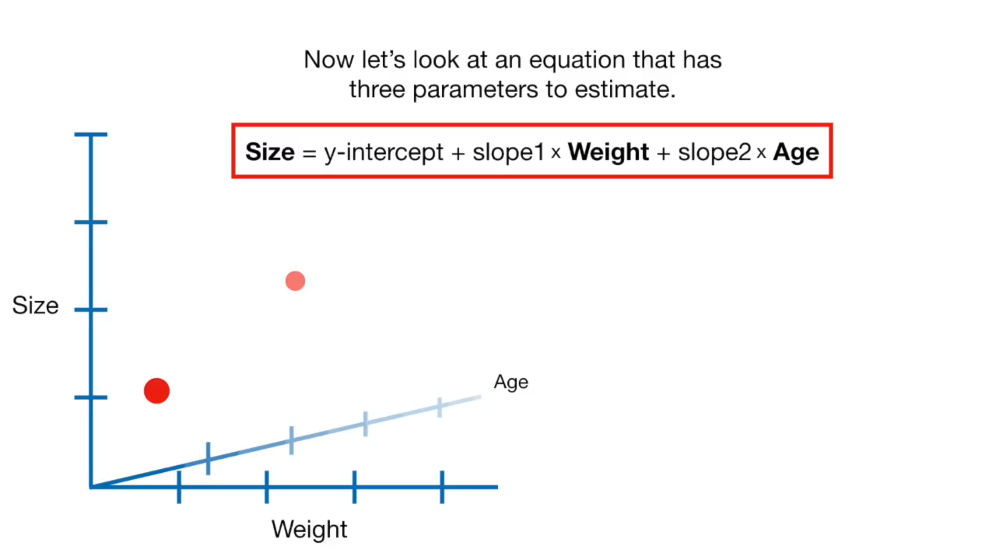

Slide 11
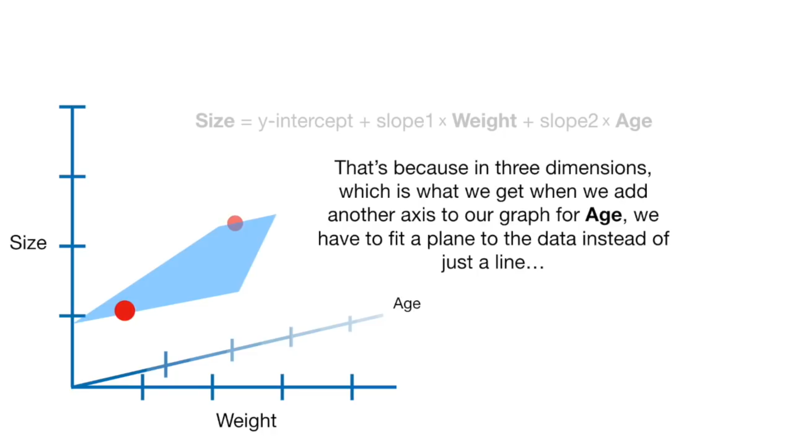

Slide 12
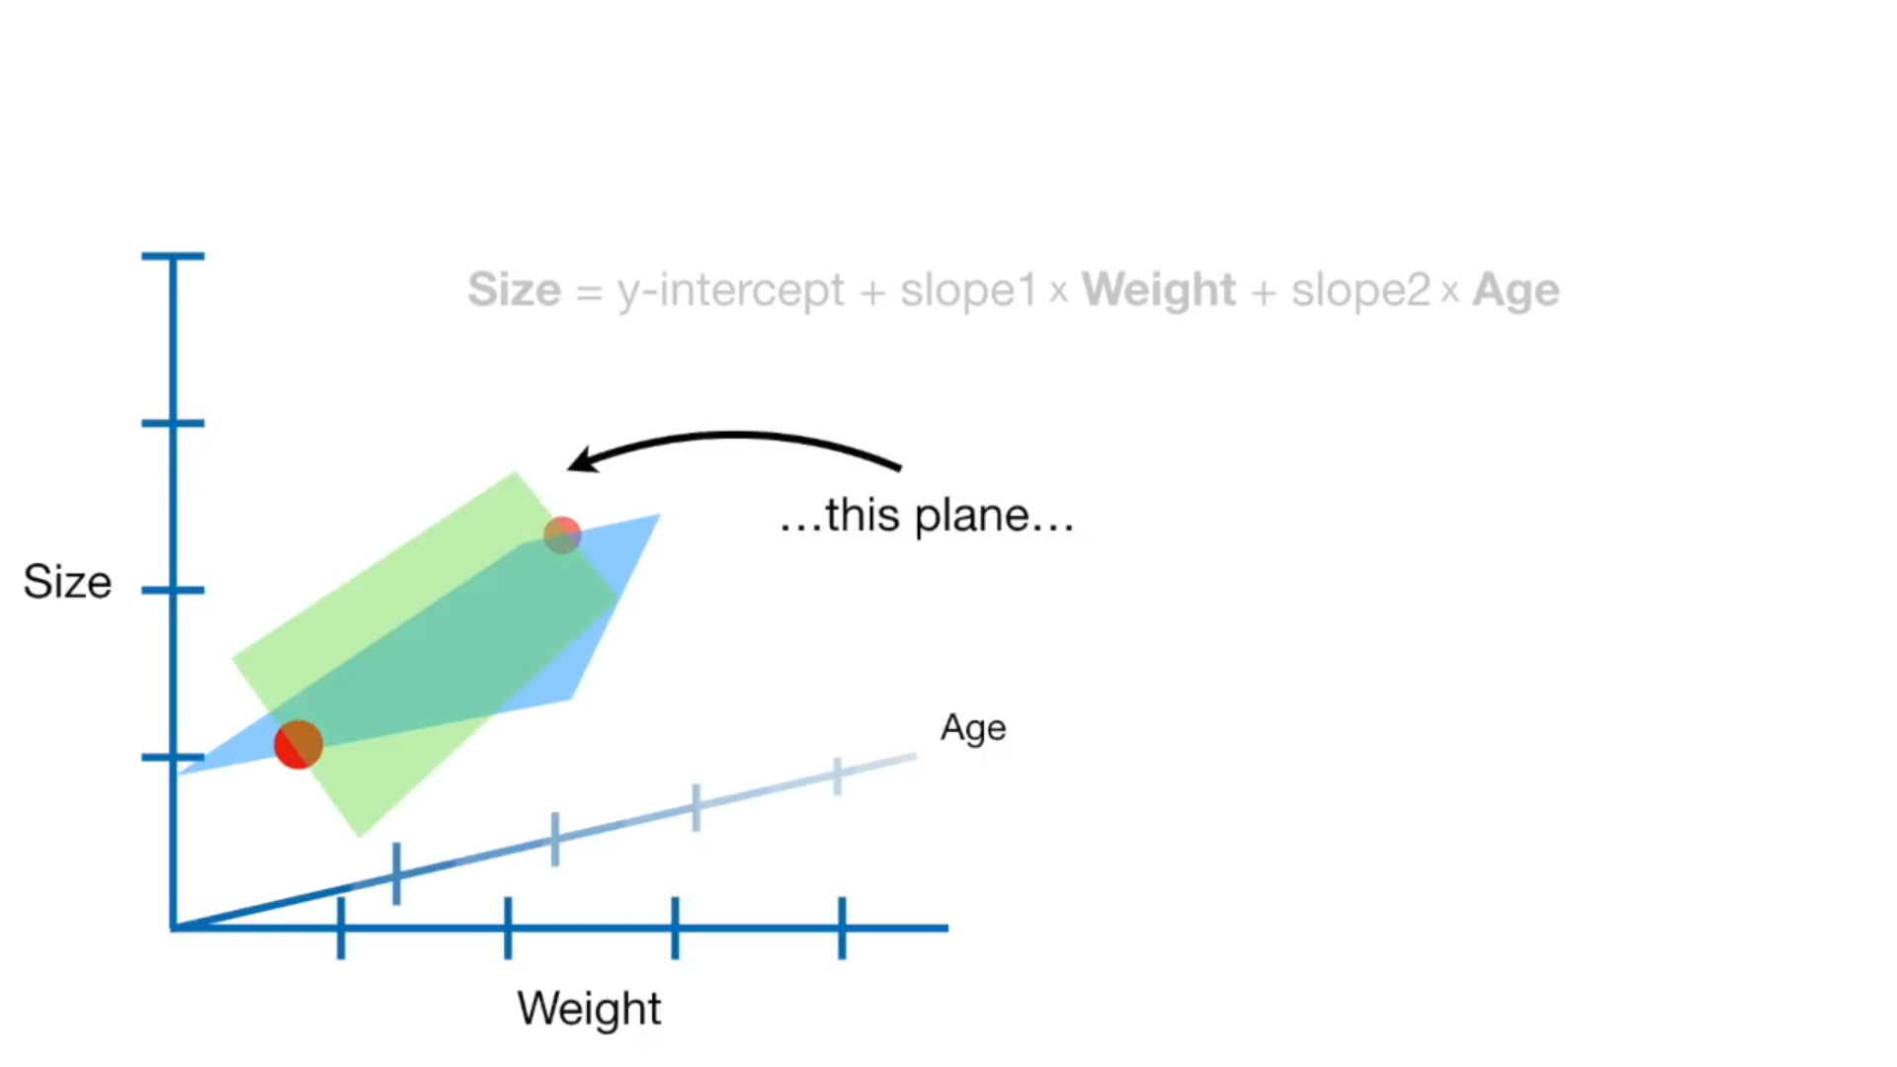

Slide 13
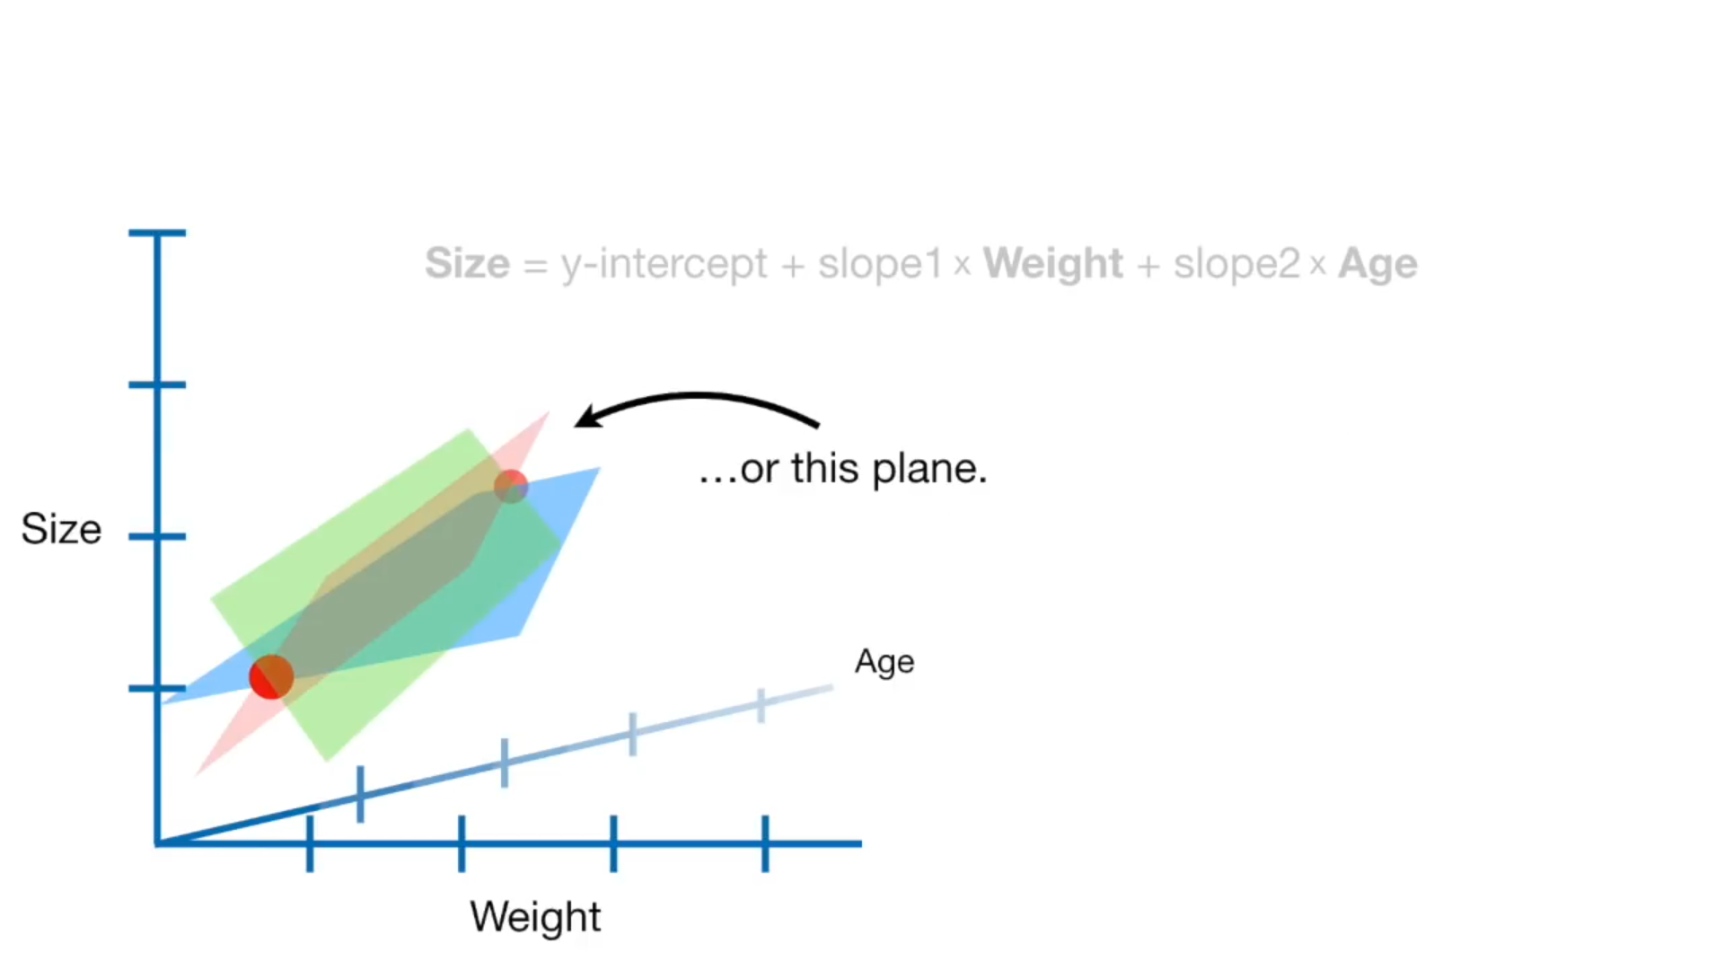

Slide 14
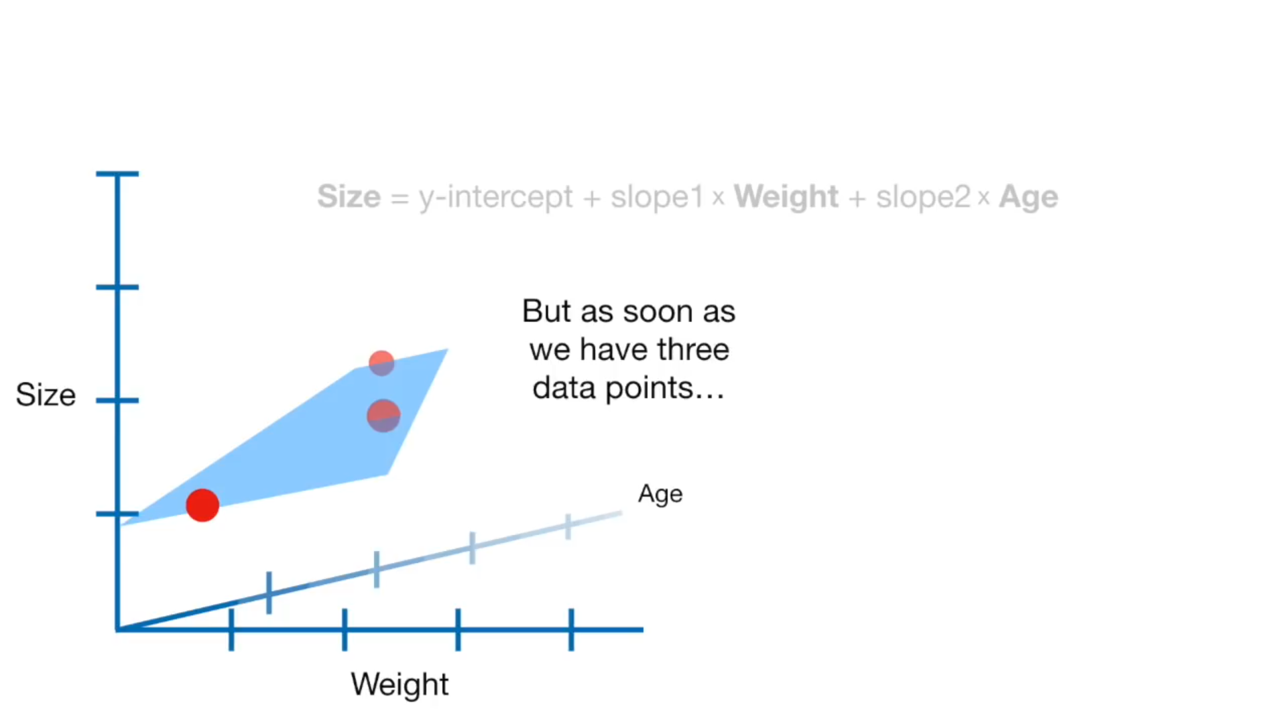

Slide 15
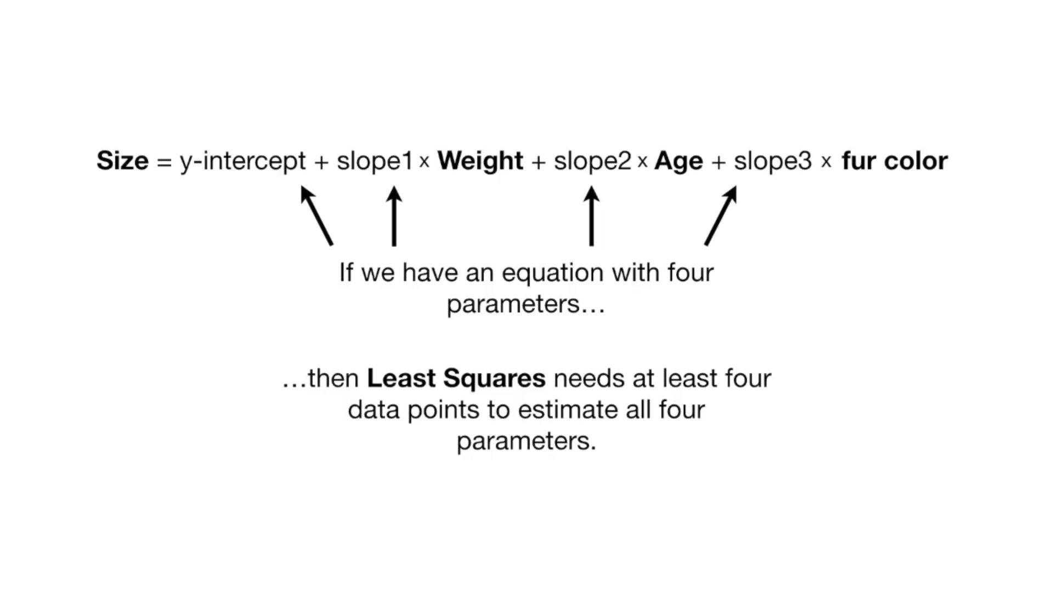

Slide 16
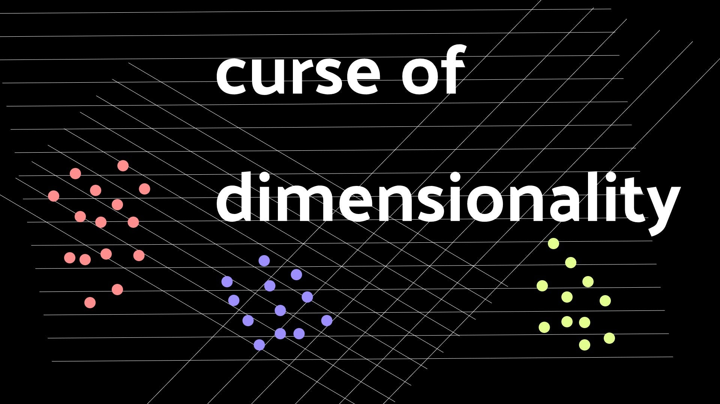

Slide 17
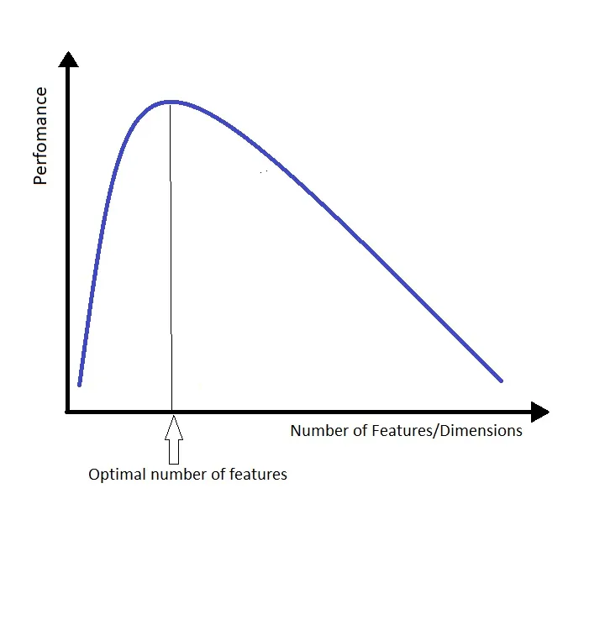

Slide 18
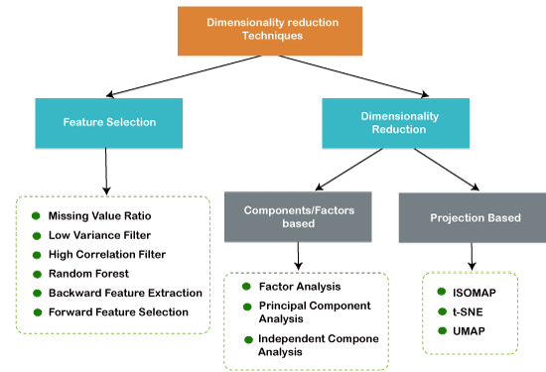

Slide 22
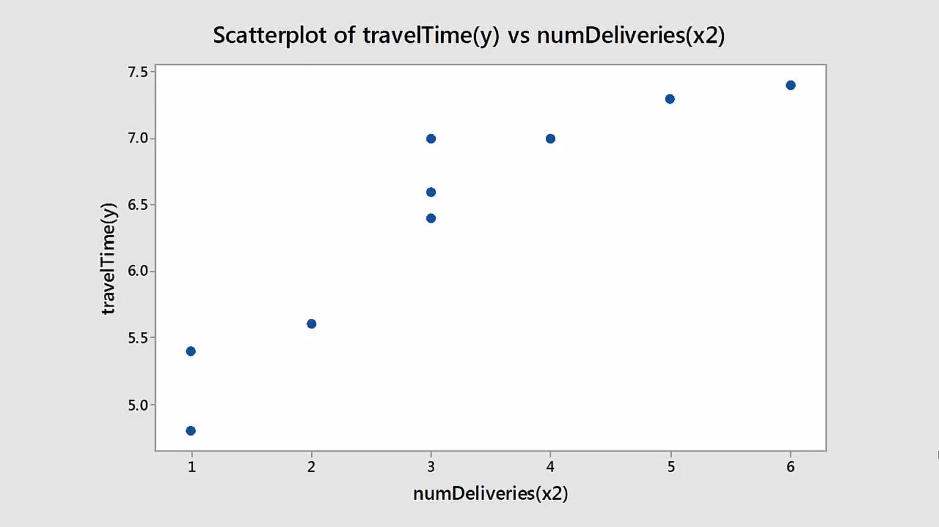

Slide 23
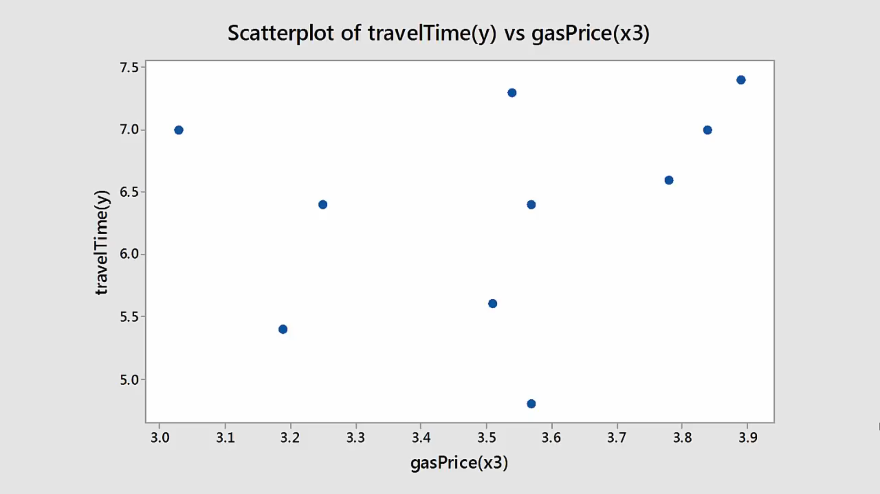

Slide 24
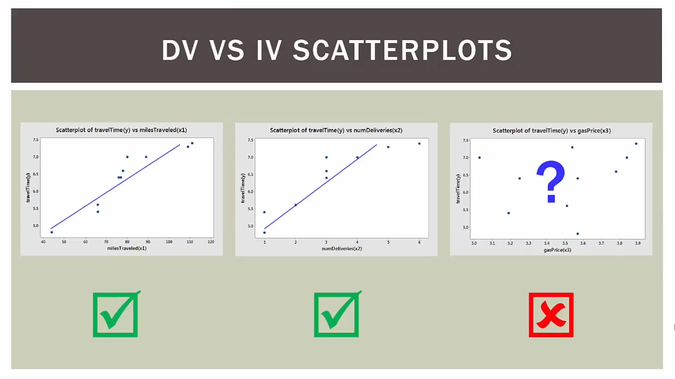

Slide 25
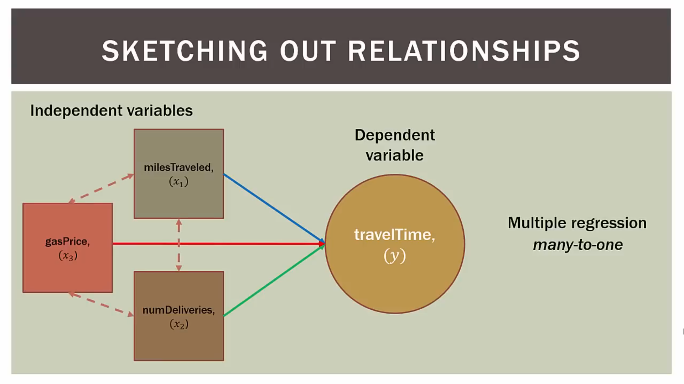

Slide 26


Slide 27
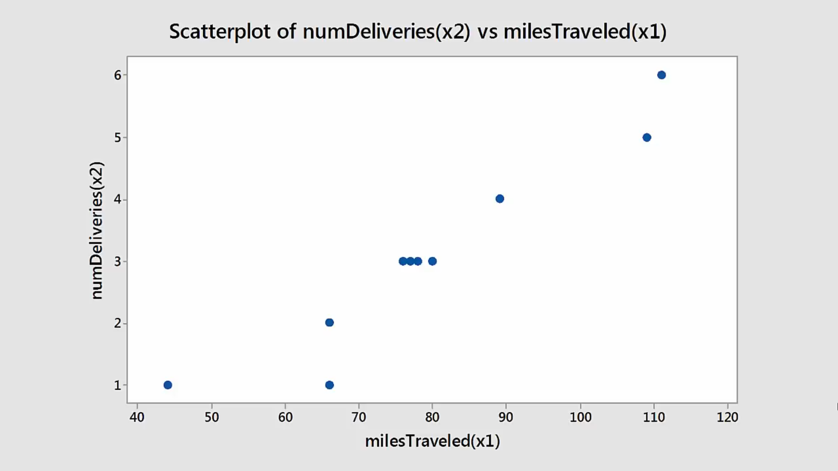

Slide 28
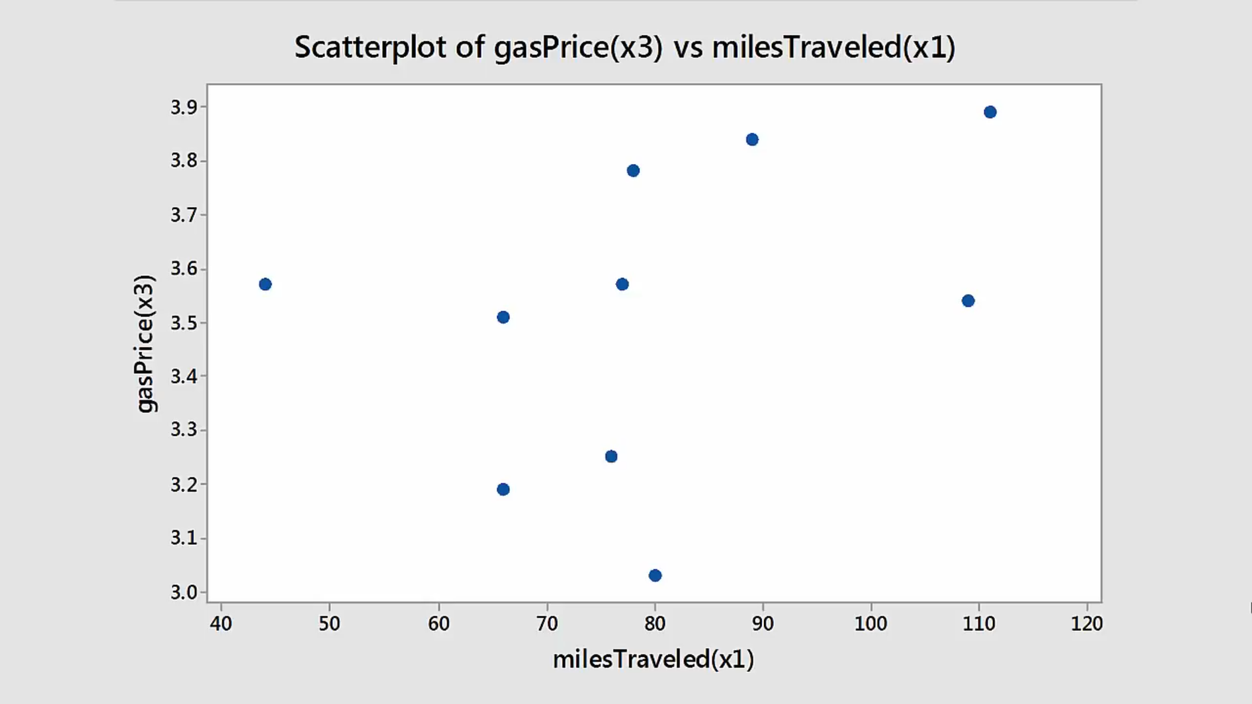

Slide 29
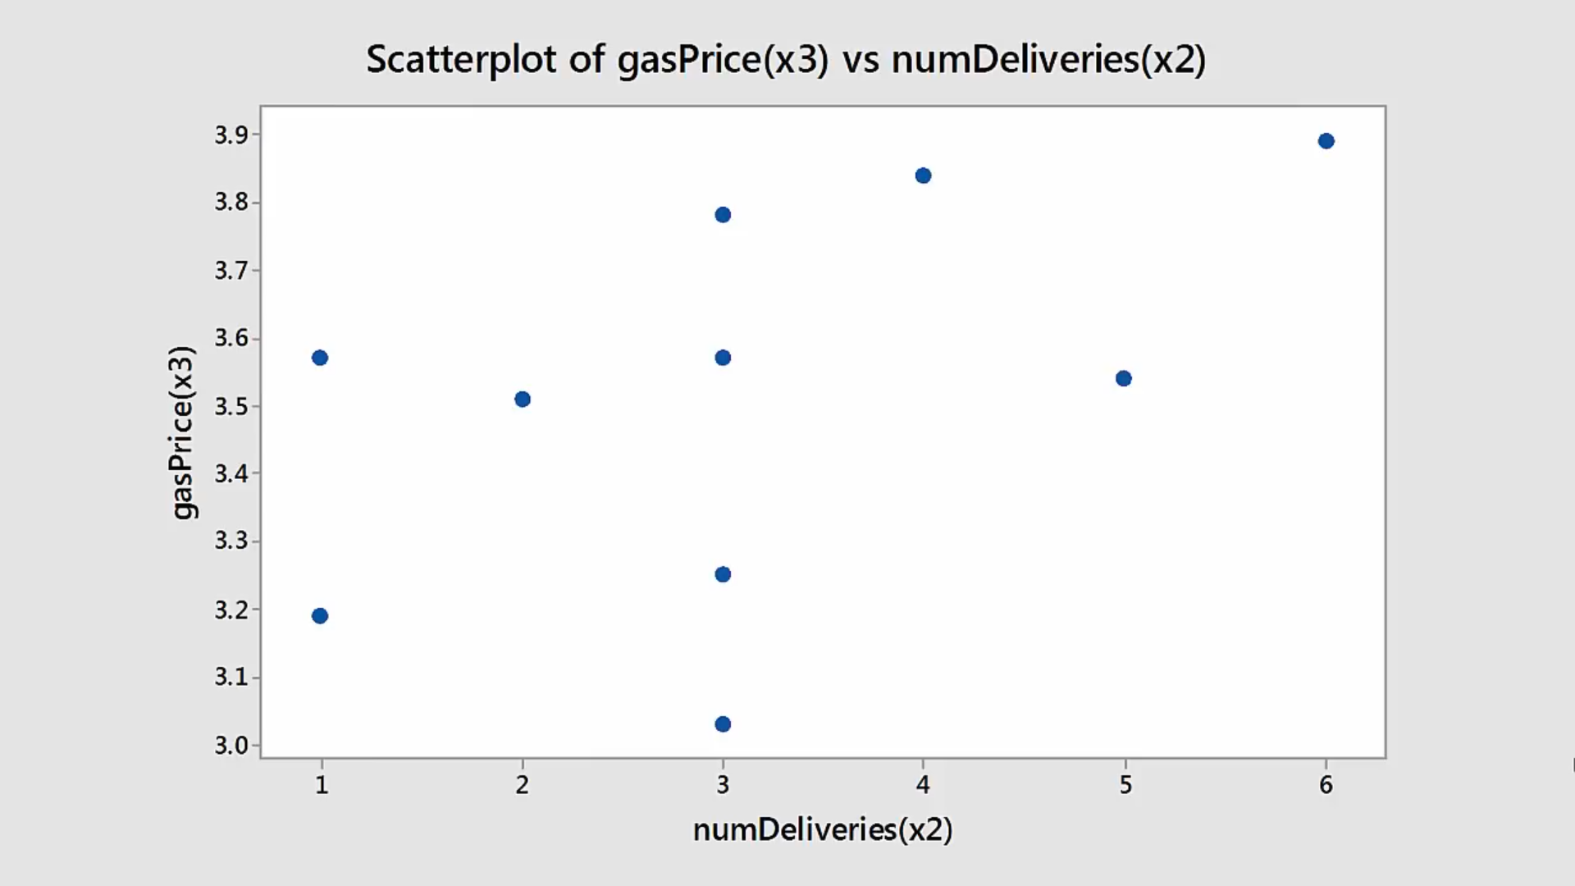

Slide 30
